Slide 1
Analyze Data on list pages Usage scenarios
Public preview
Business Central
2023 release wave 1

Slide 2
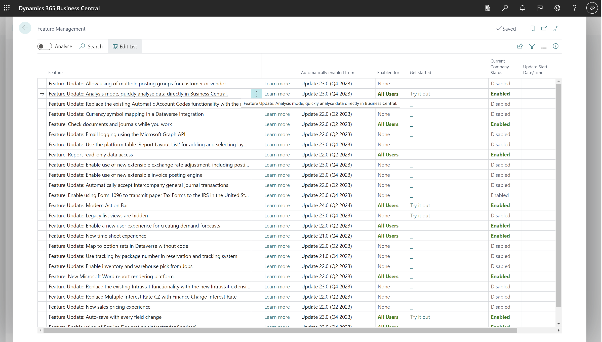
Enable under Feature Management

Slide 3
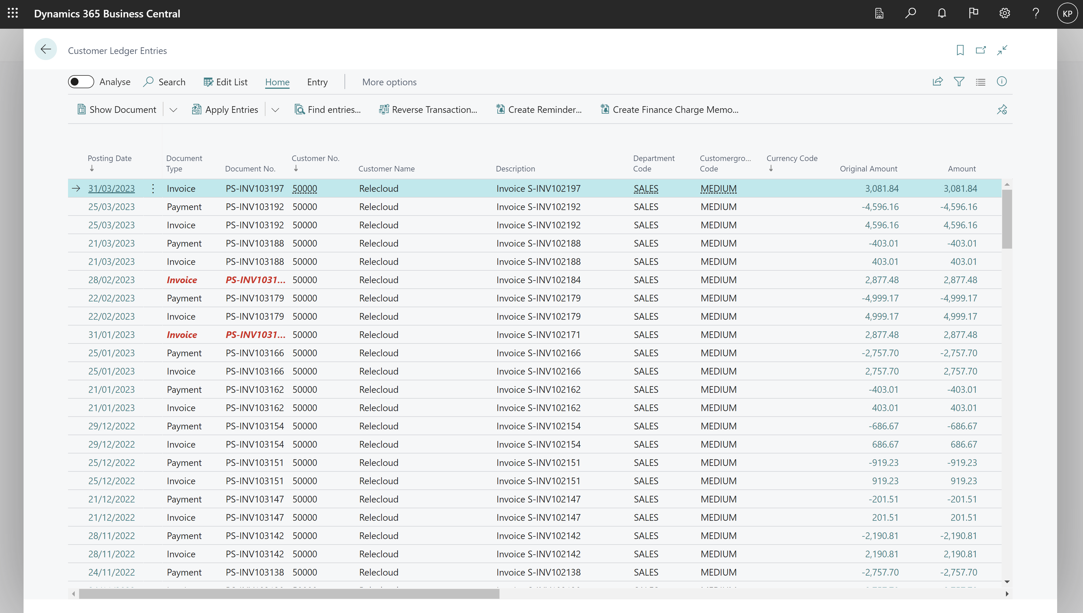
Analyze Data on a list page

Slide 4
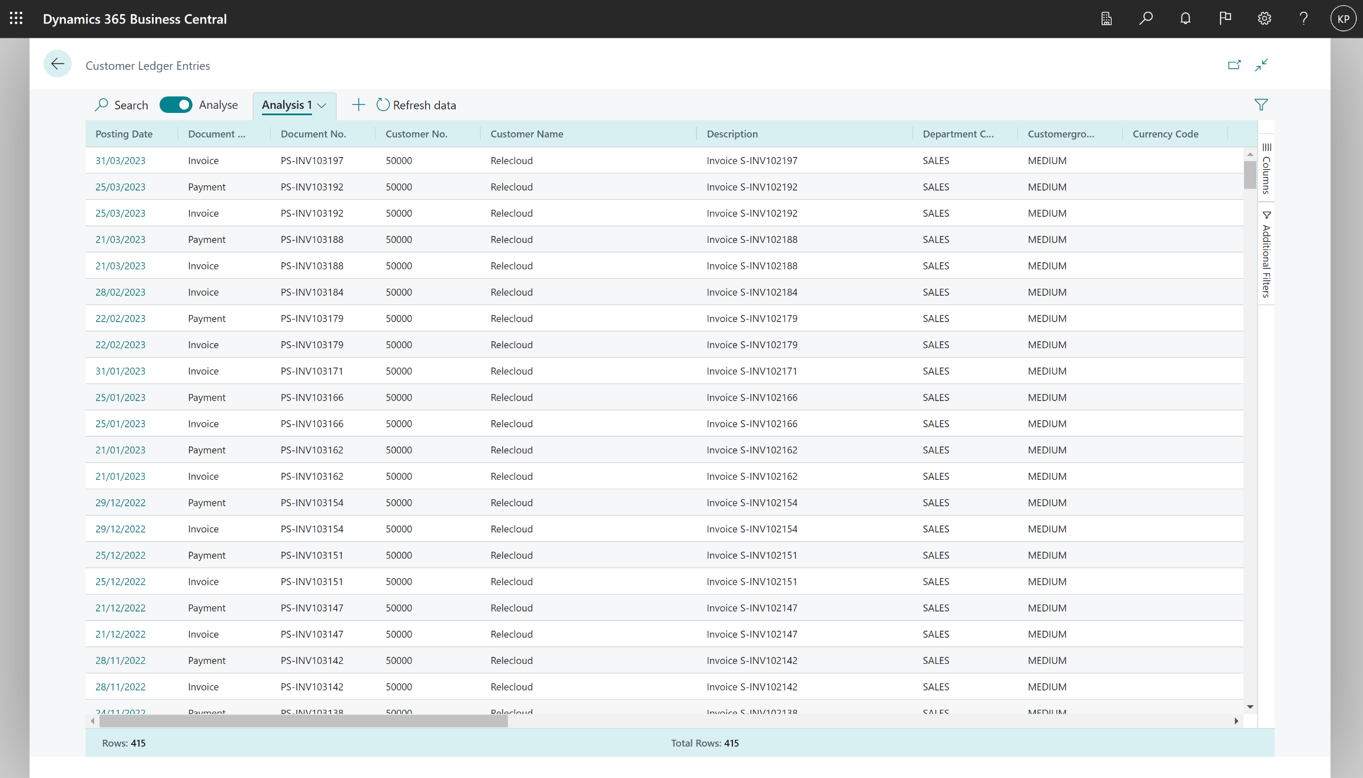
Opens the list with additional analysis capabilities

Slide 5
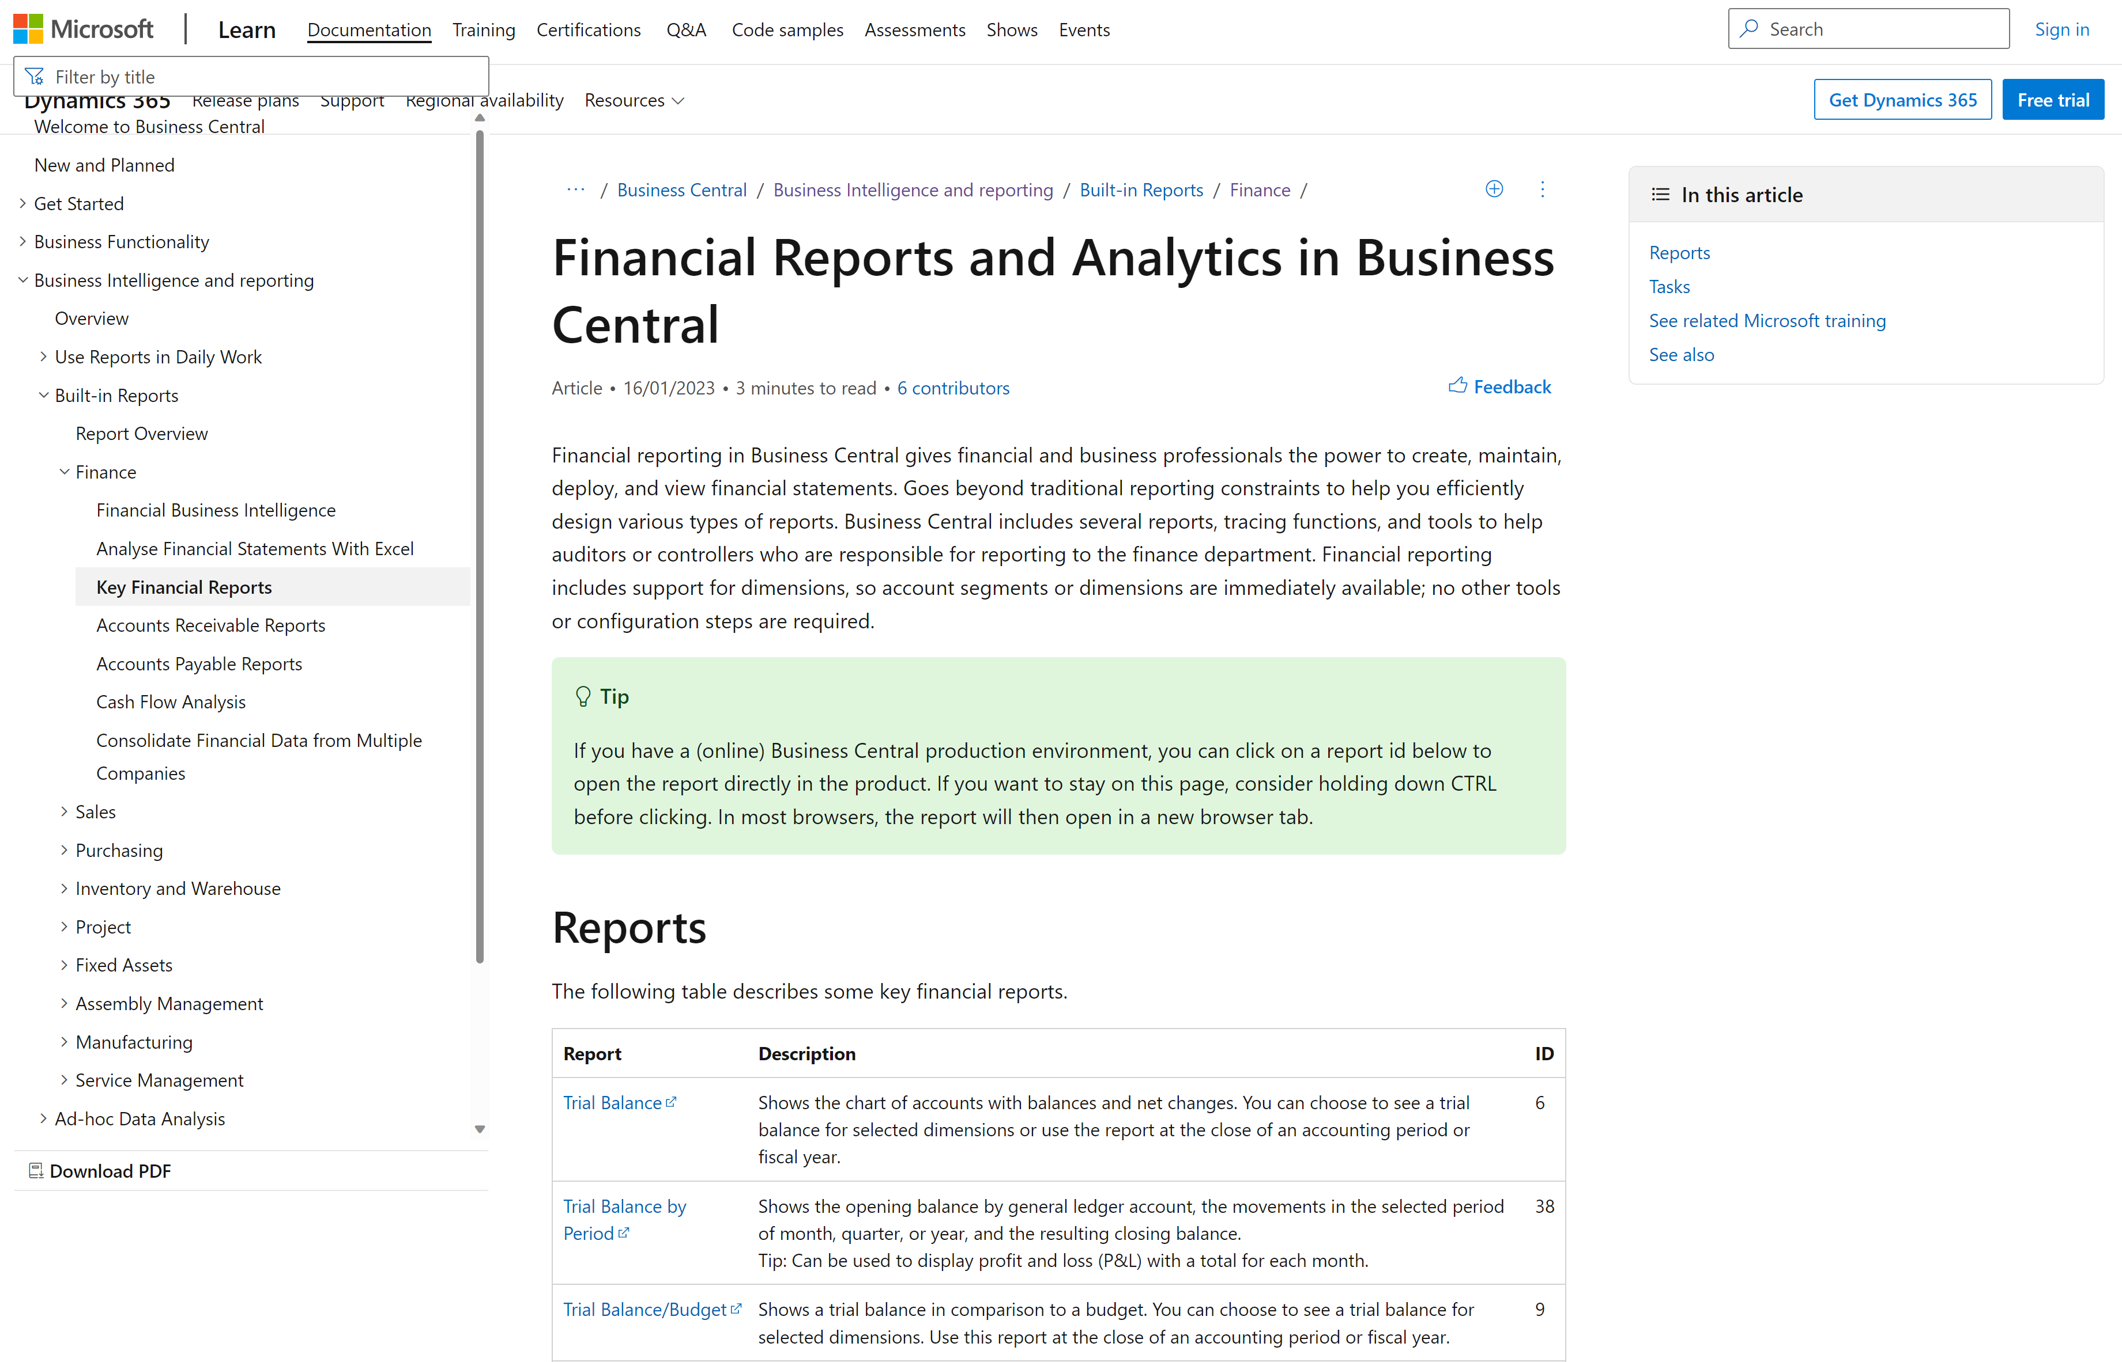
https://aka.ms/bcreporting

Slide 6
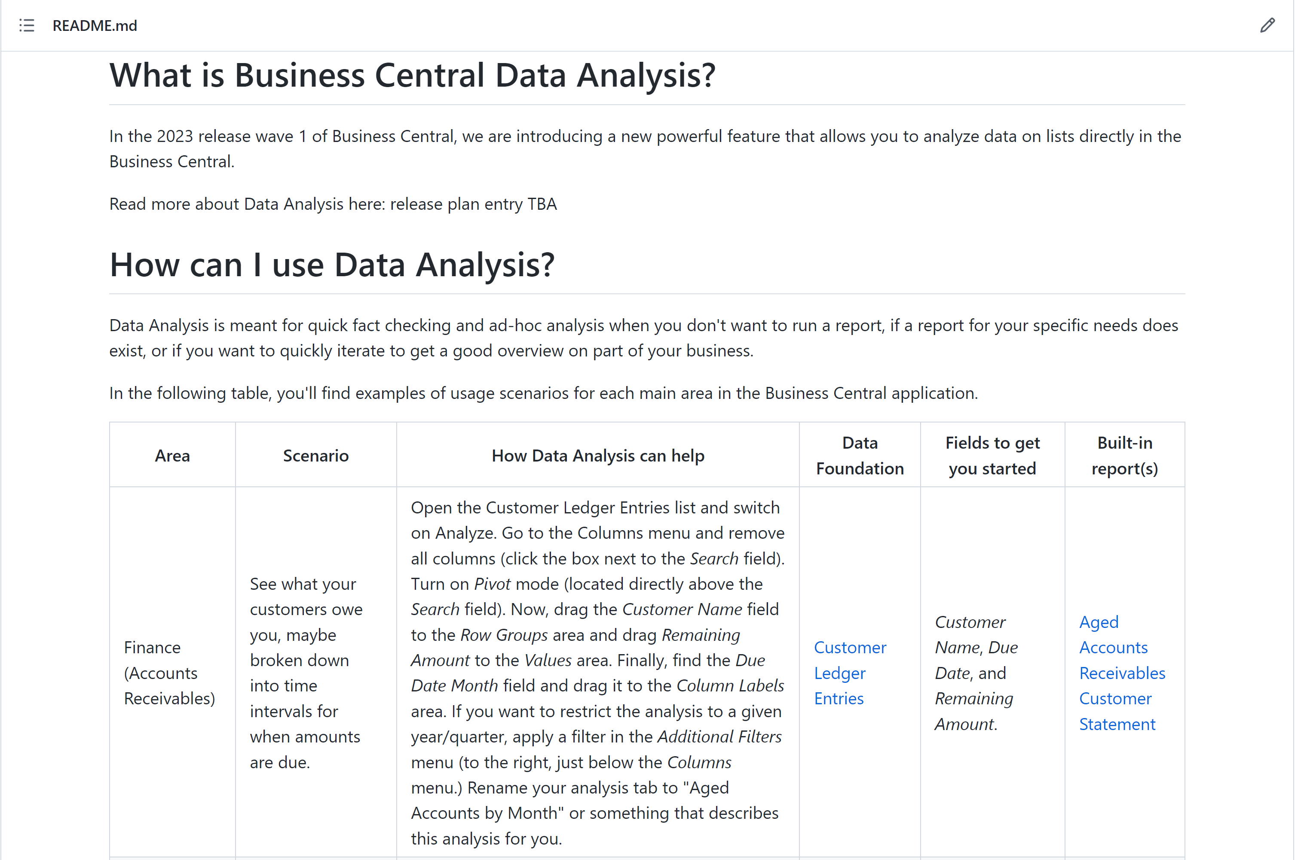
https://aka.ms/bcdataanalysis

Slide 7
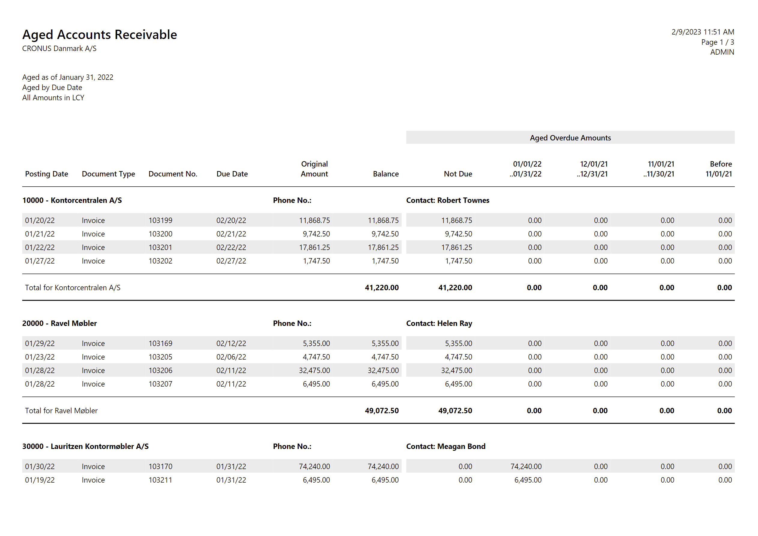
Before: run a report, get a pdf

Slide 8
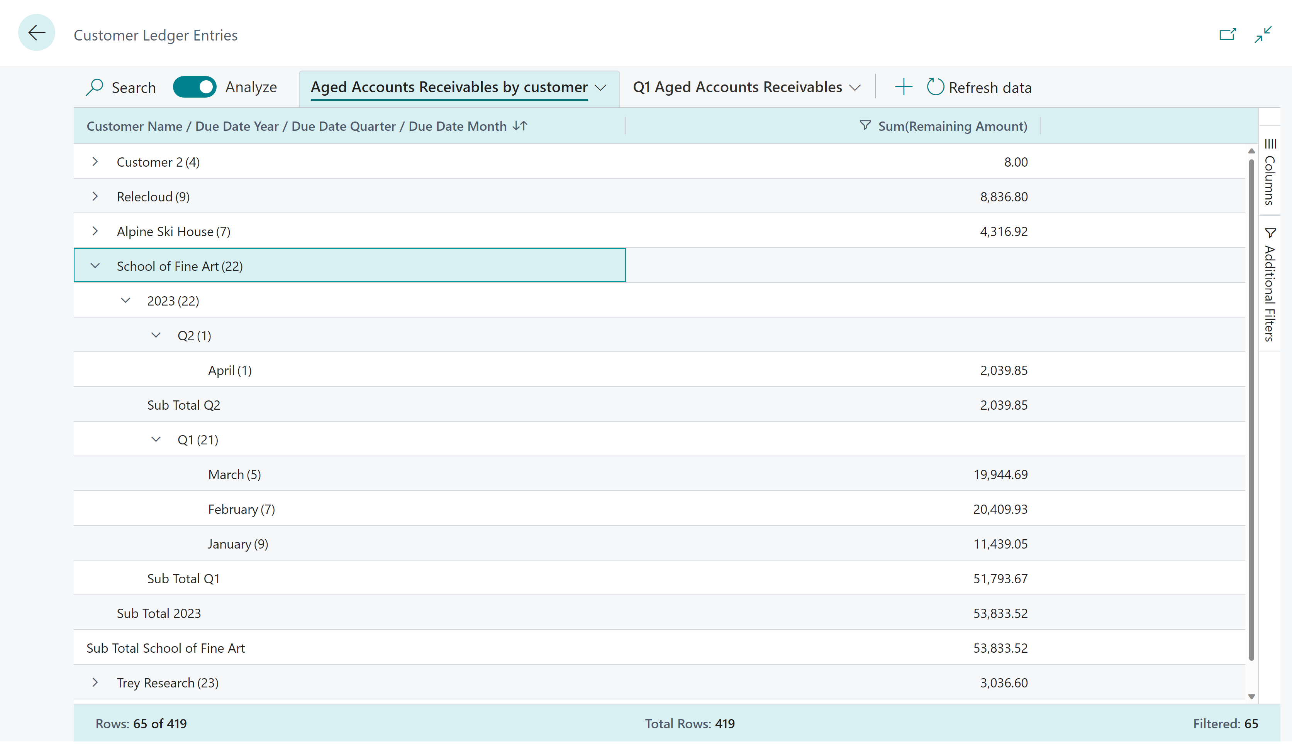
Now: self-service with Data Analysis

Slide 9
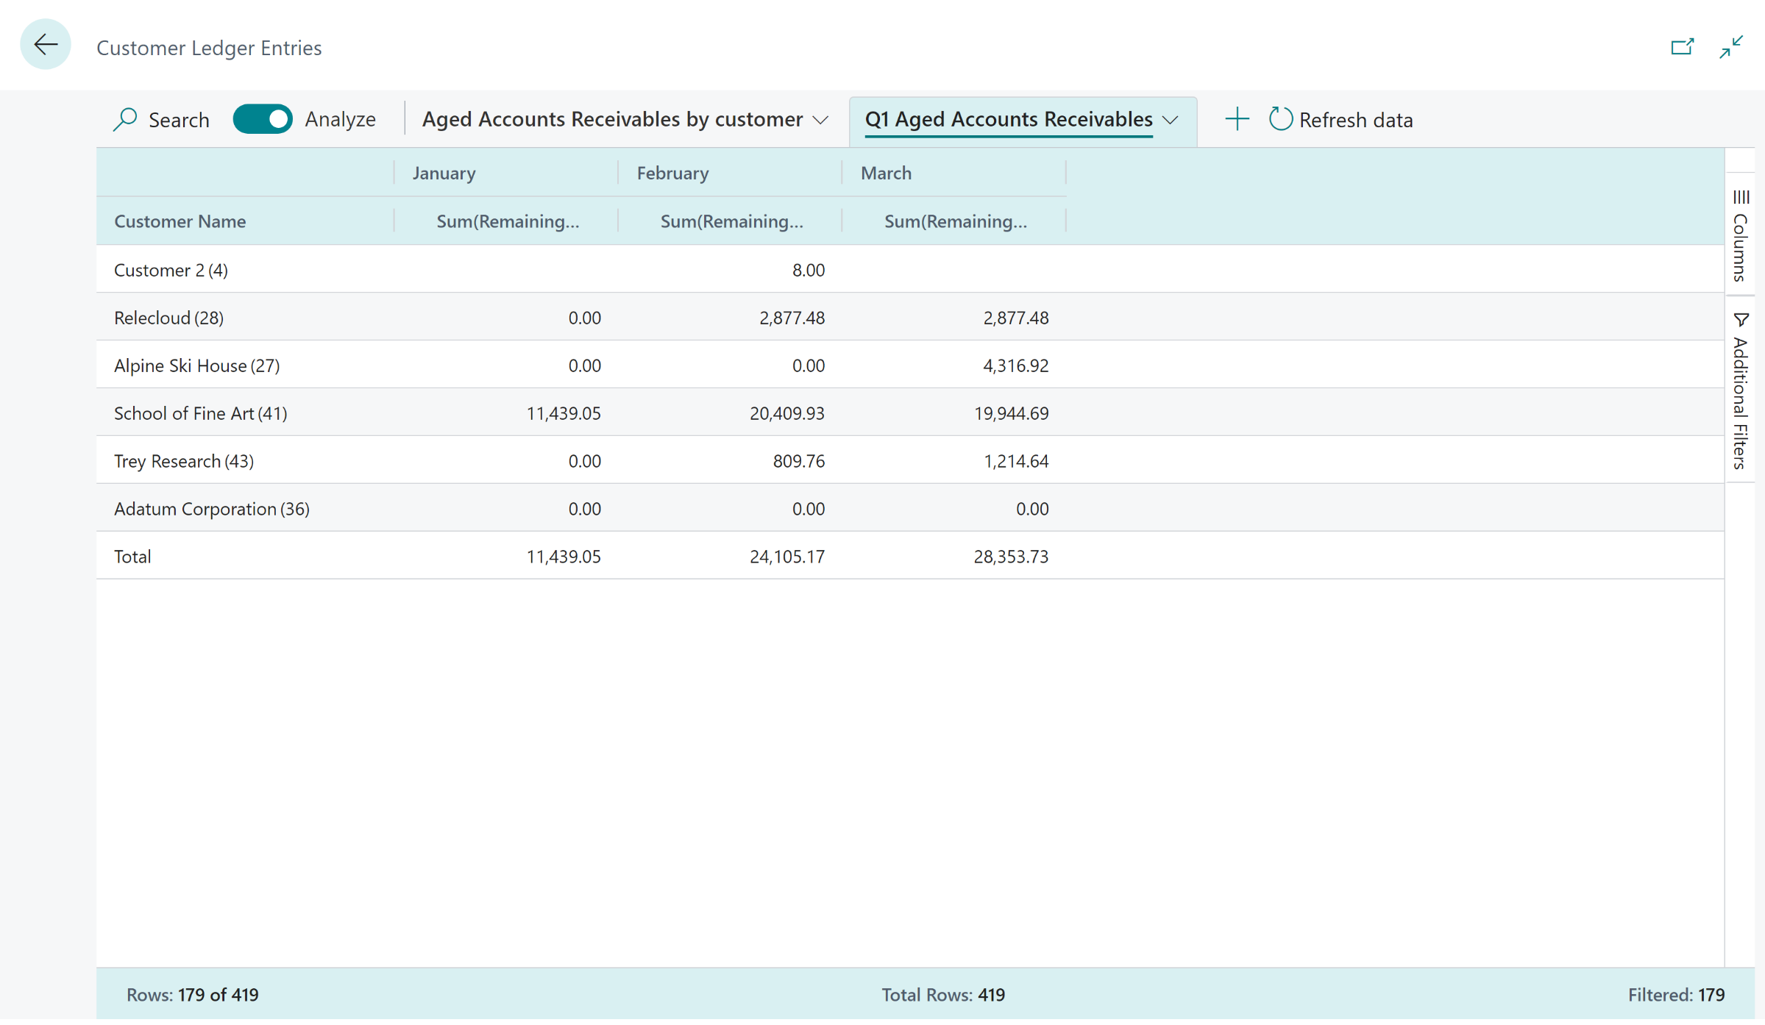
Now: self-service with Analysis Mode

Slide 10
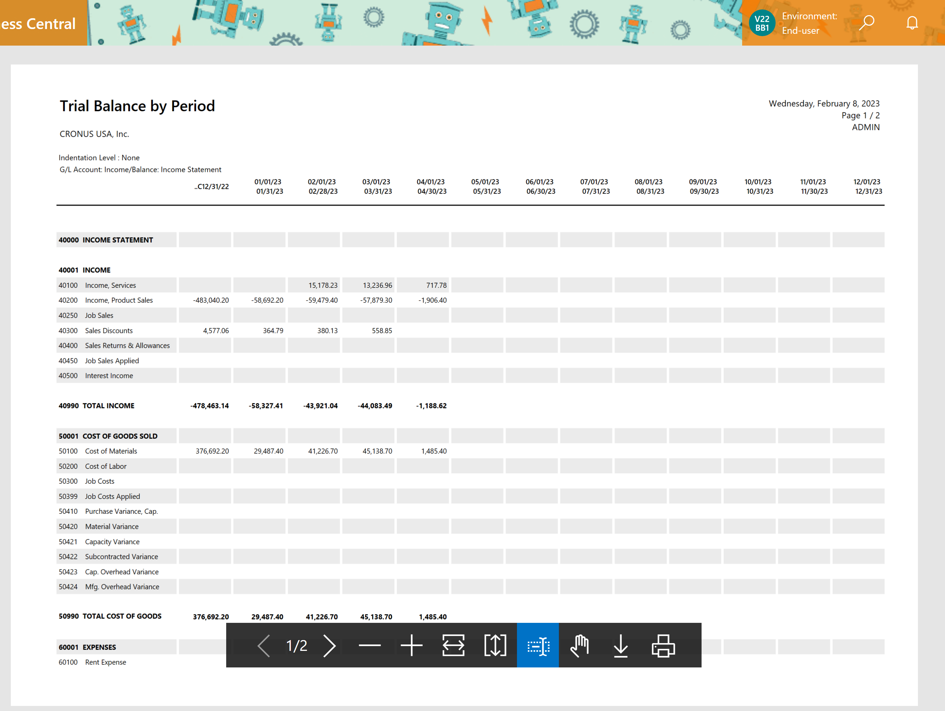
Before: Income statement as a pdf

Slide 11
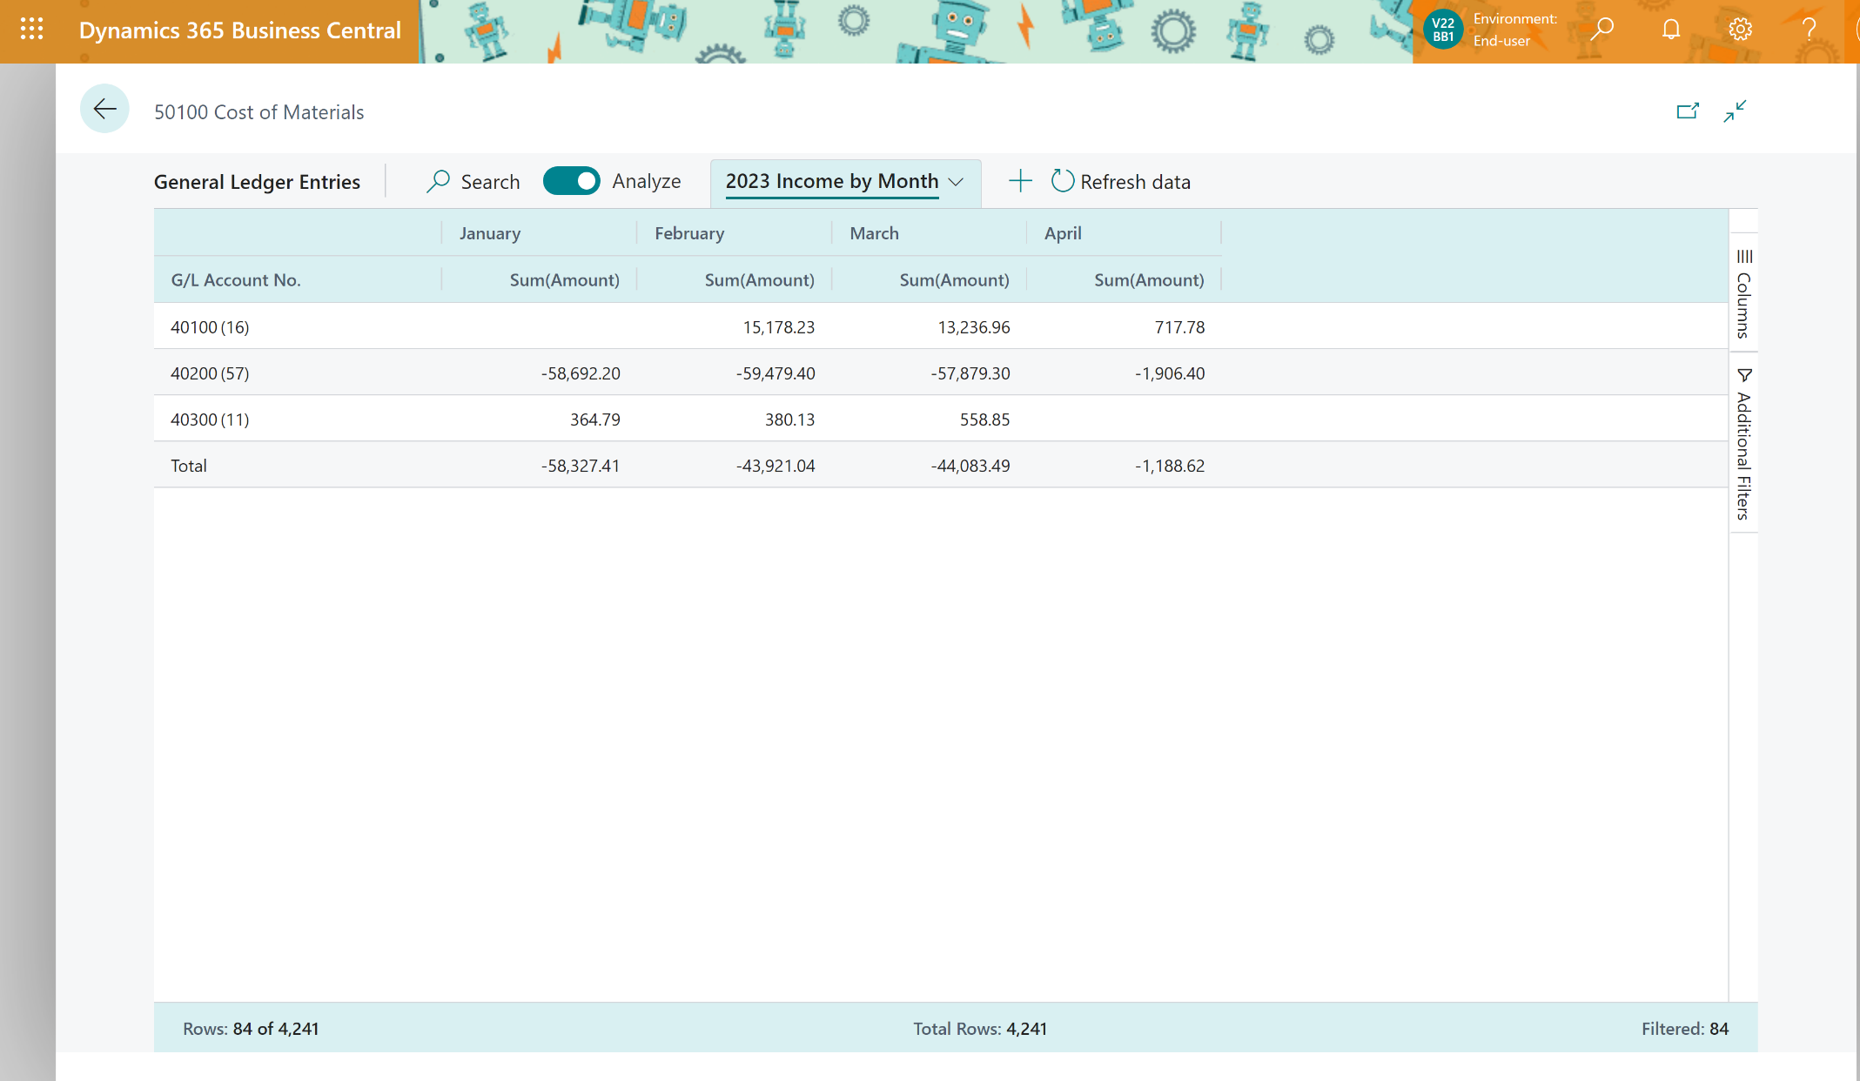
Now: Click-clickety-click income statement with Analysis mode

Slide 12
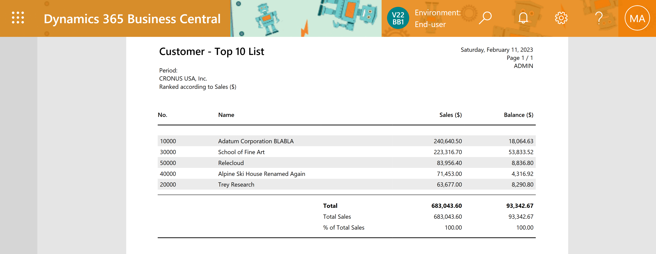
Customer top 10 list

Slide 13
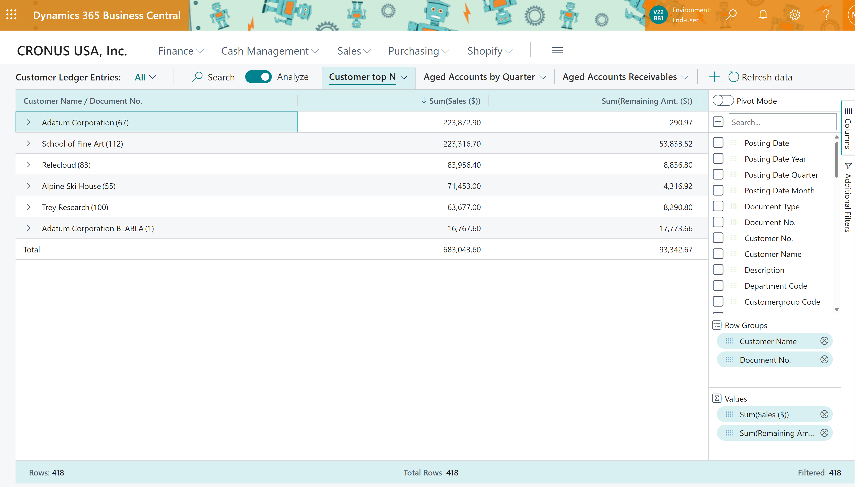
DIY Customer top N

Slide 14
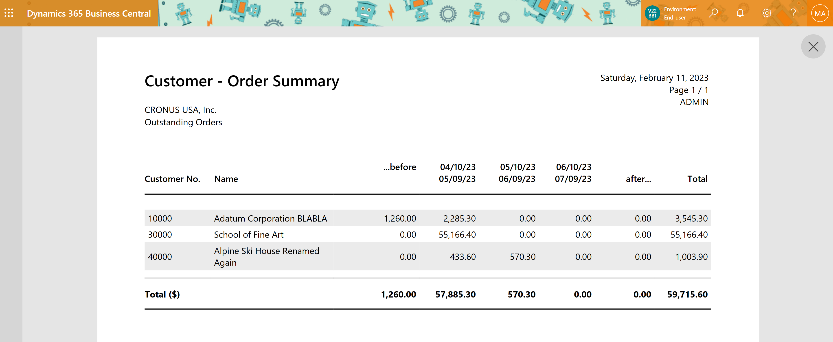
Customer - Order Summary

Slide 15
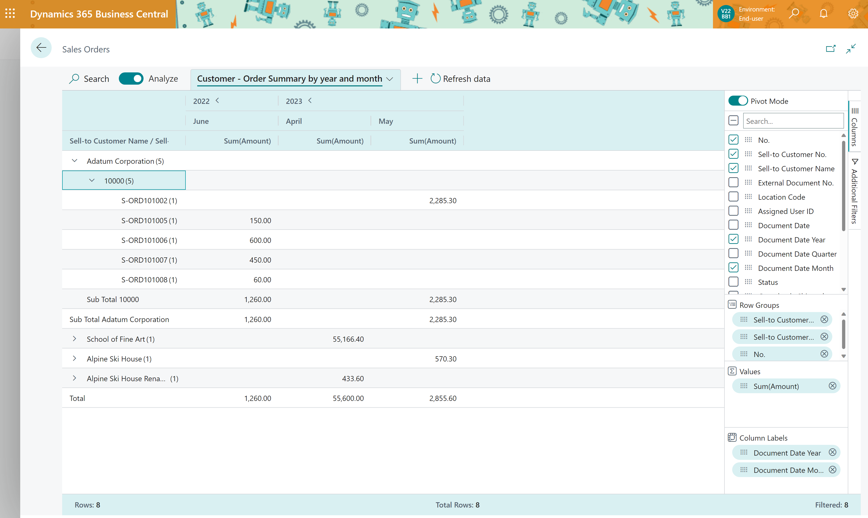
DIY Customer - Order Summary

Slide 16
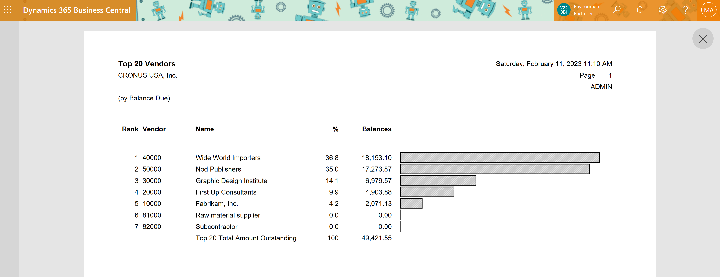
Top N vendors (by balance)

Slide 17
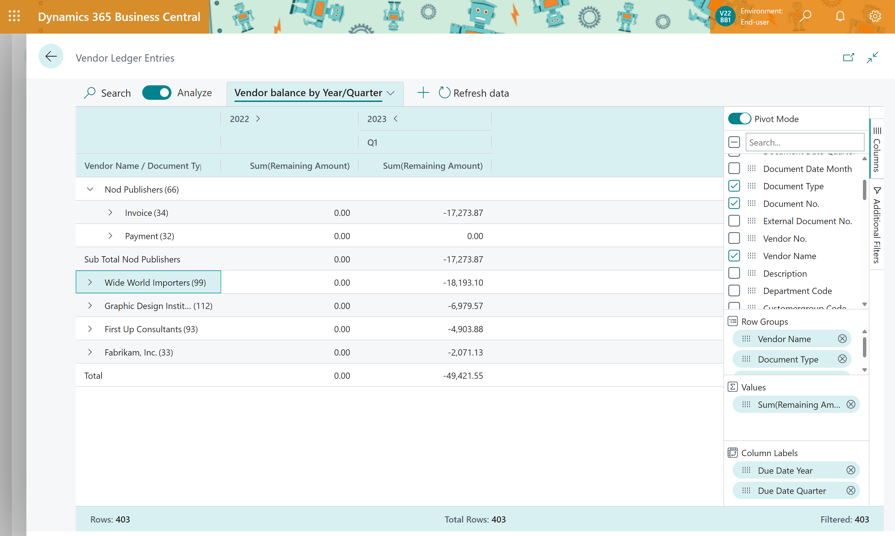
DIY Top N vendors (by balance)

Slide 18
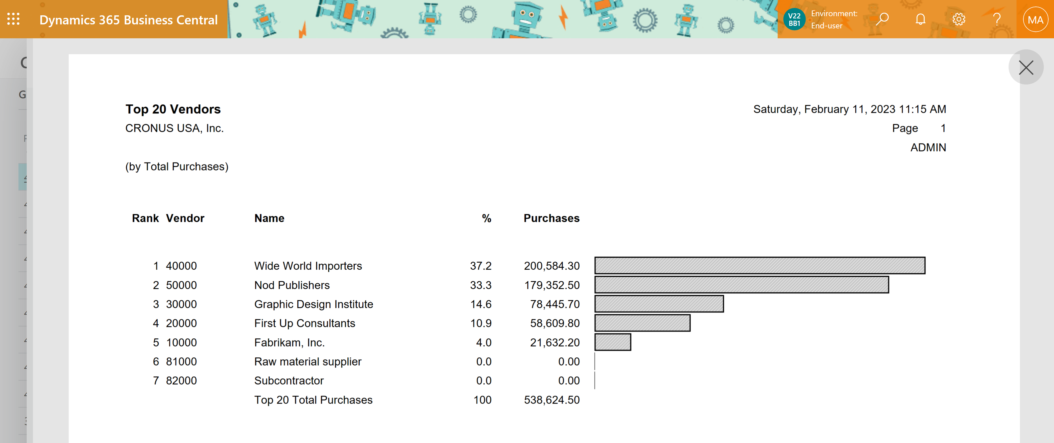
Top N vendors (by purchase)

Slide 19
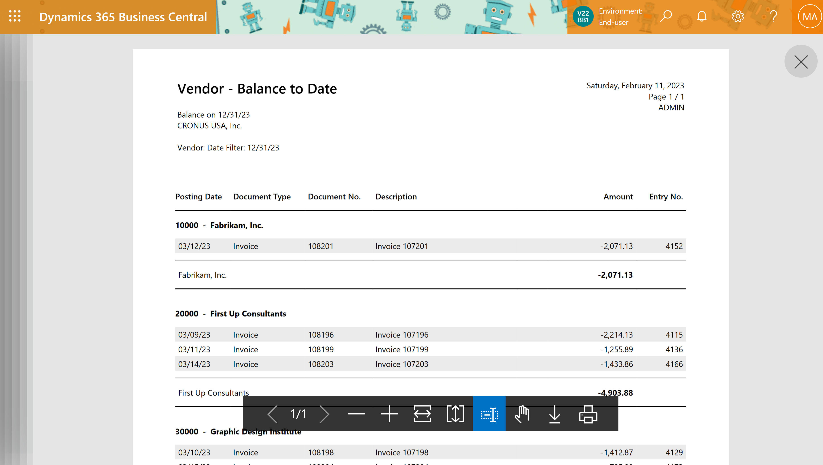
Vendor - Balance to Date

Slide 20
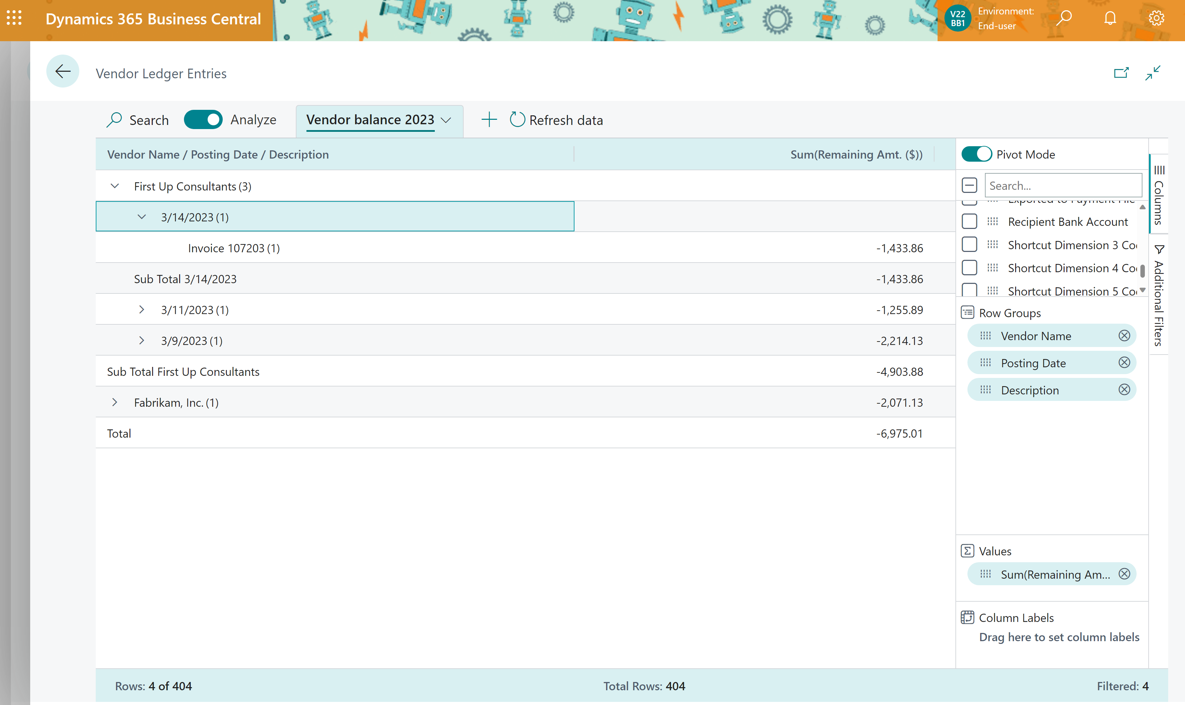
DIY Vendor - Balance to Date

Slide 21
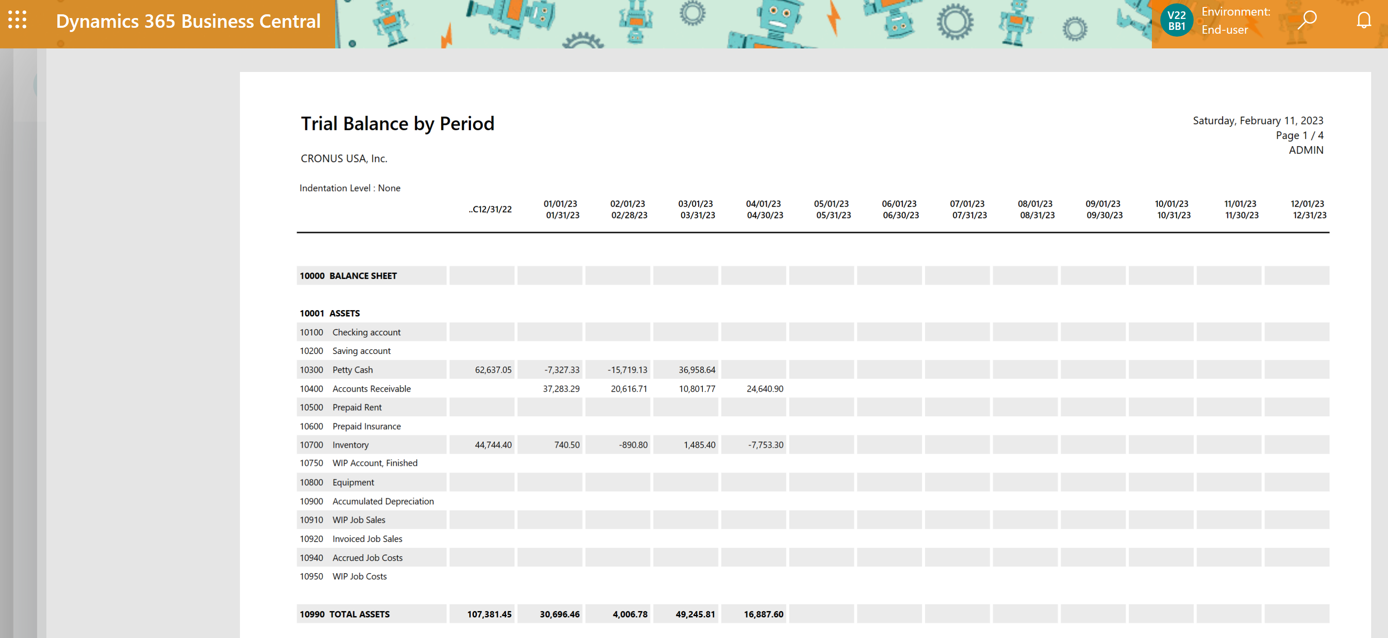
Total Assets report

Slide 22
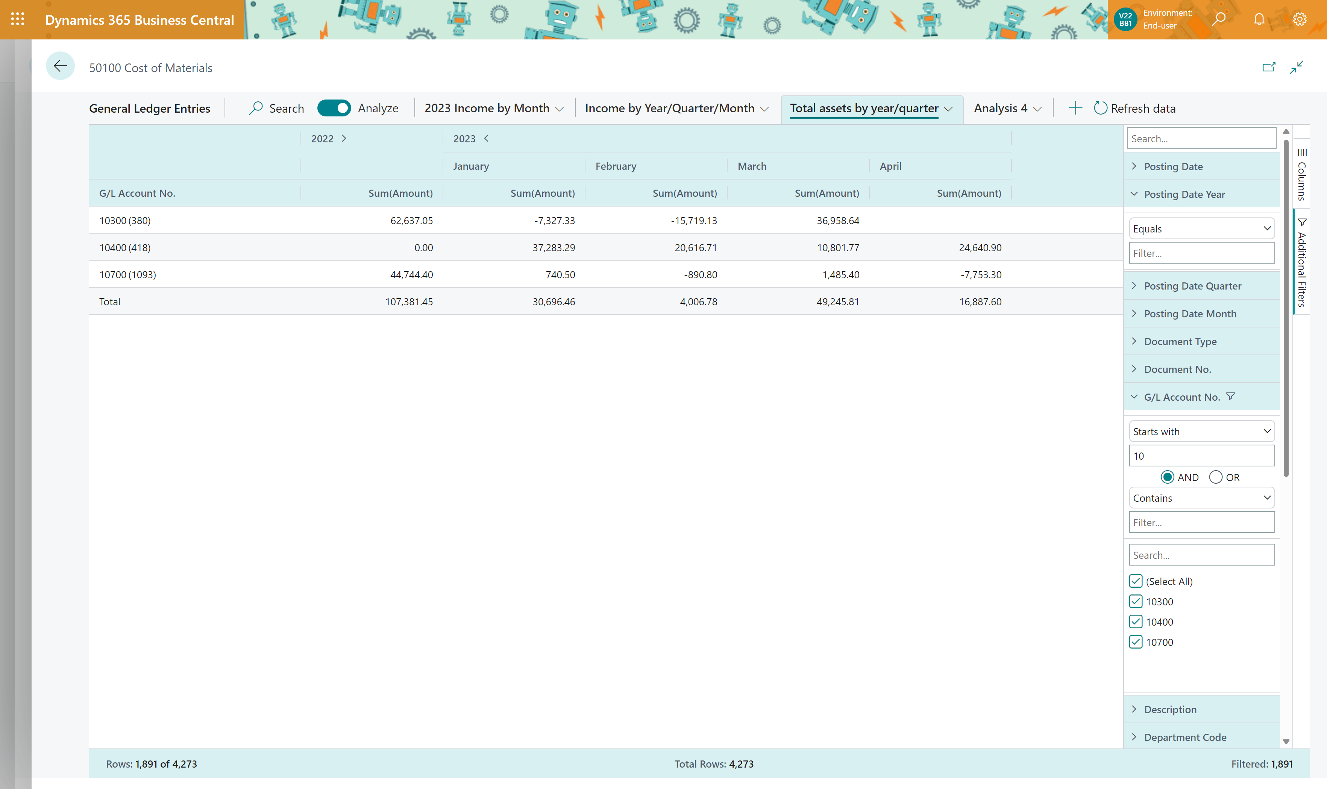
DYI Total Assets report

Slide 23
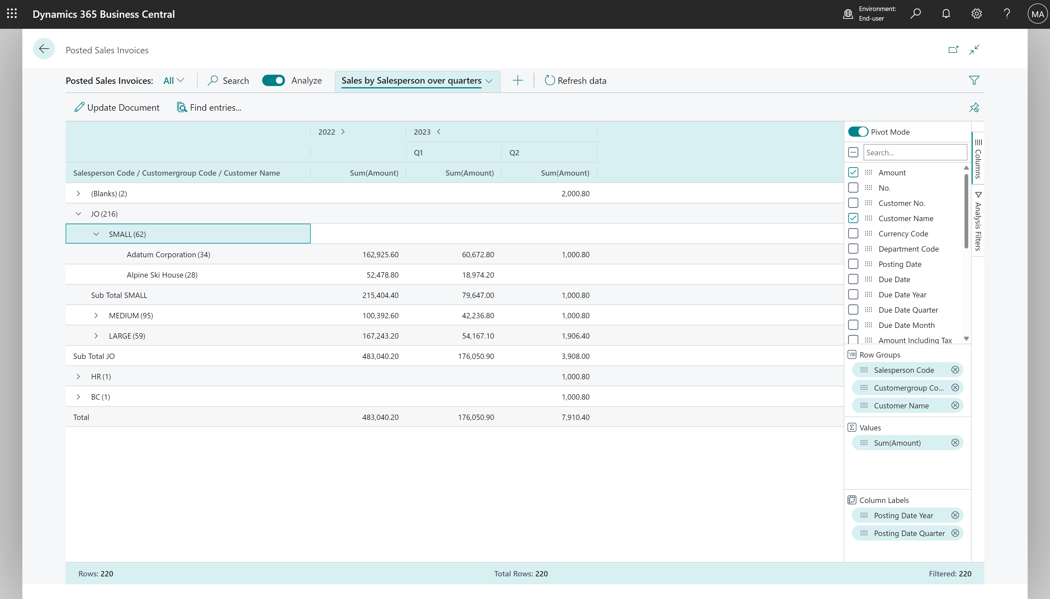
Salesperson bonus overview

Slide 24
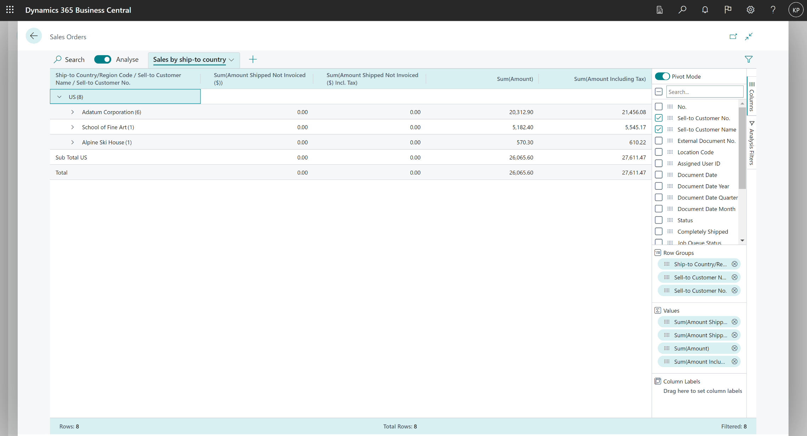
Sales by ship-to country

Slide 25
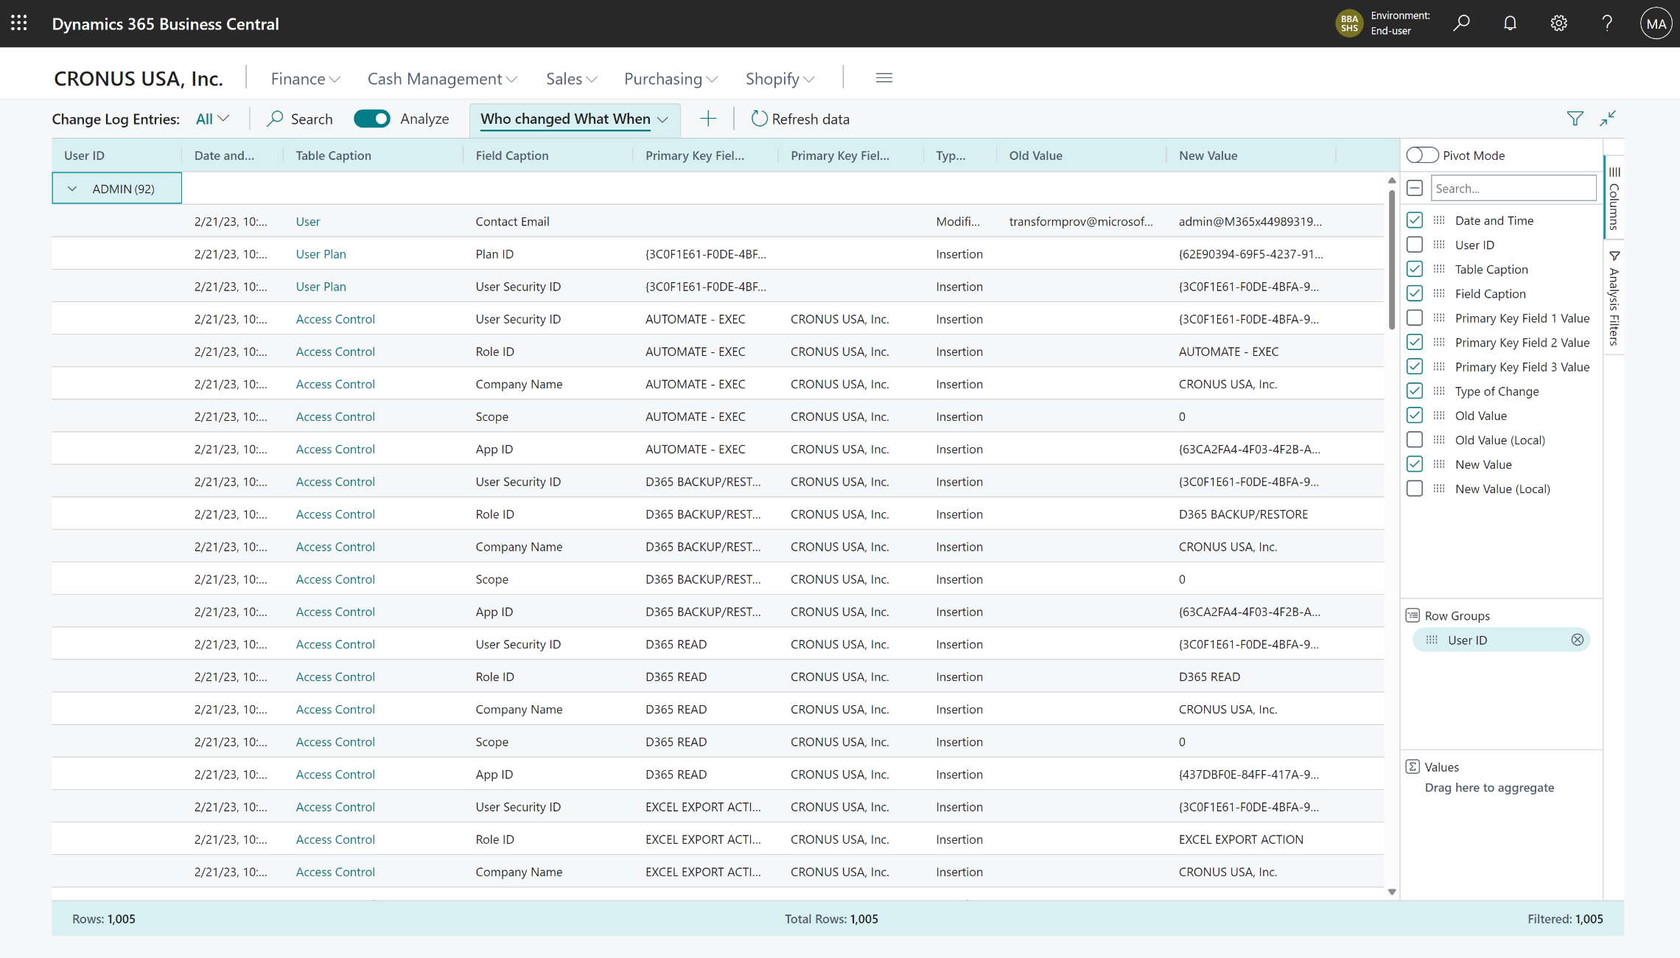
Compliance: Who changed What When

Slide 26
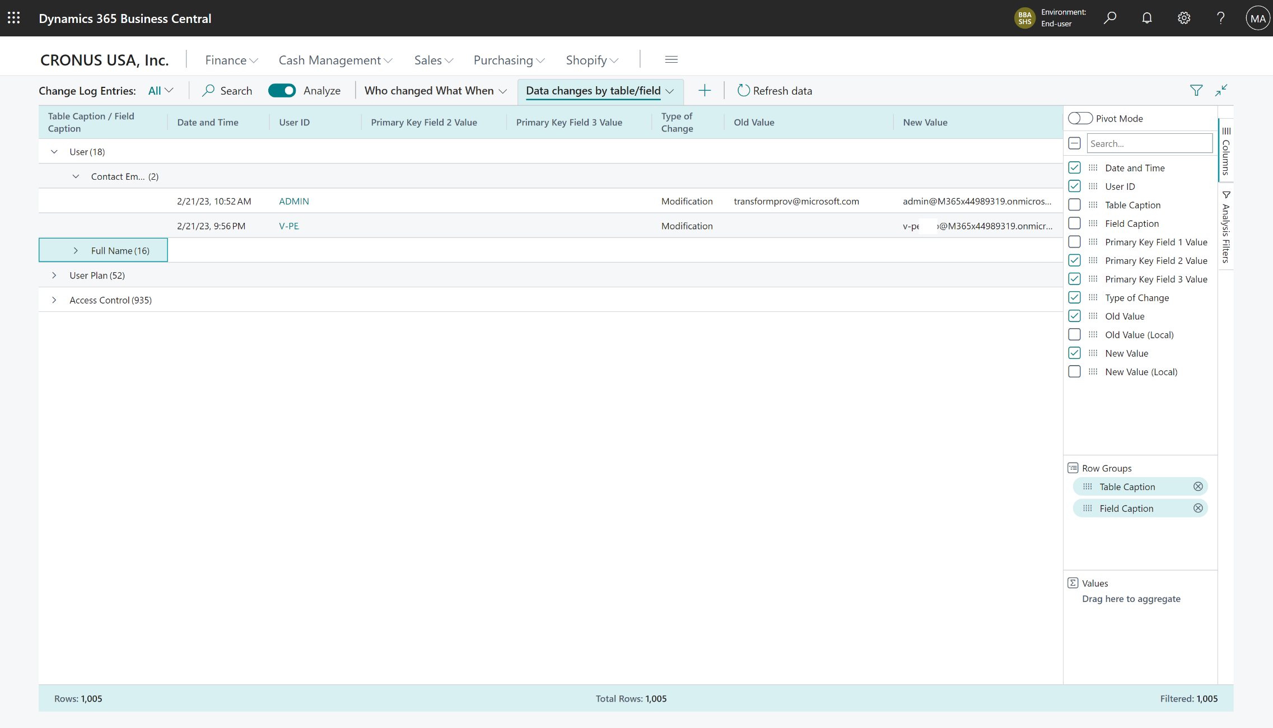
Compliance: Data Changes by table/field

Slide 27
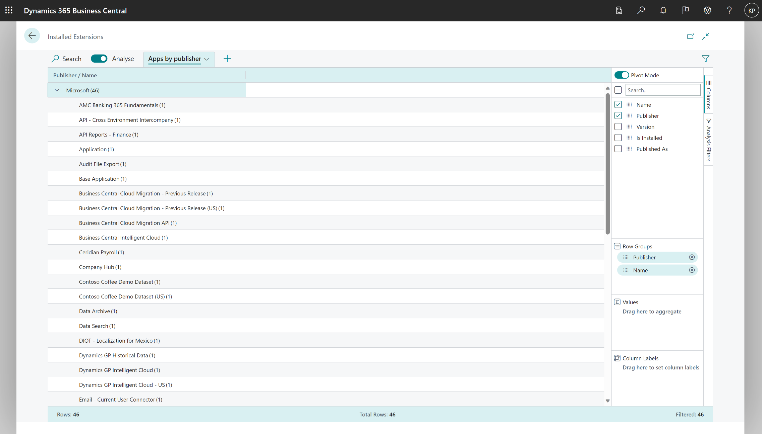
Compliance: Installed apps by publisher

Slide 28
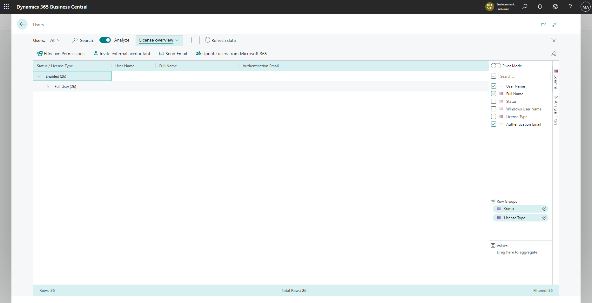
Compliance: License overview by user

Slide 29
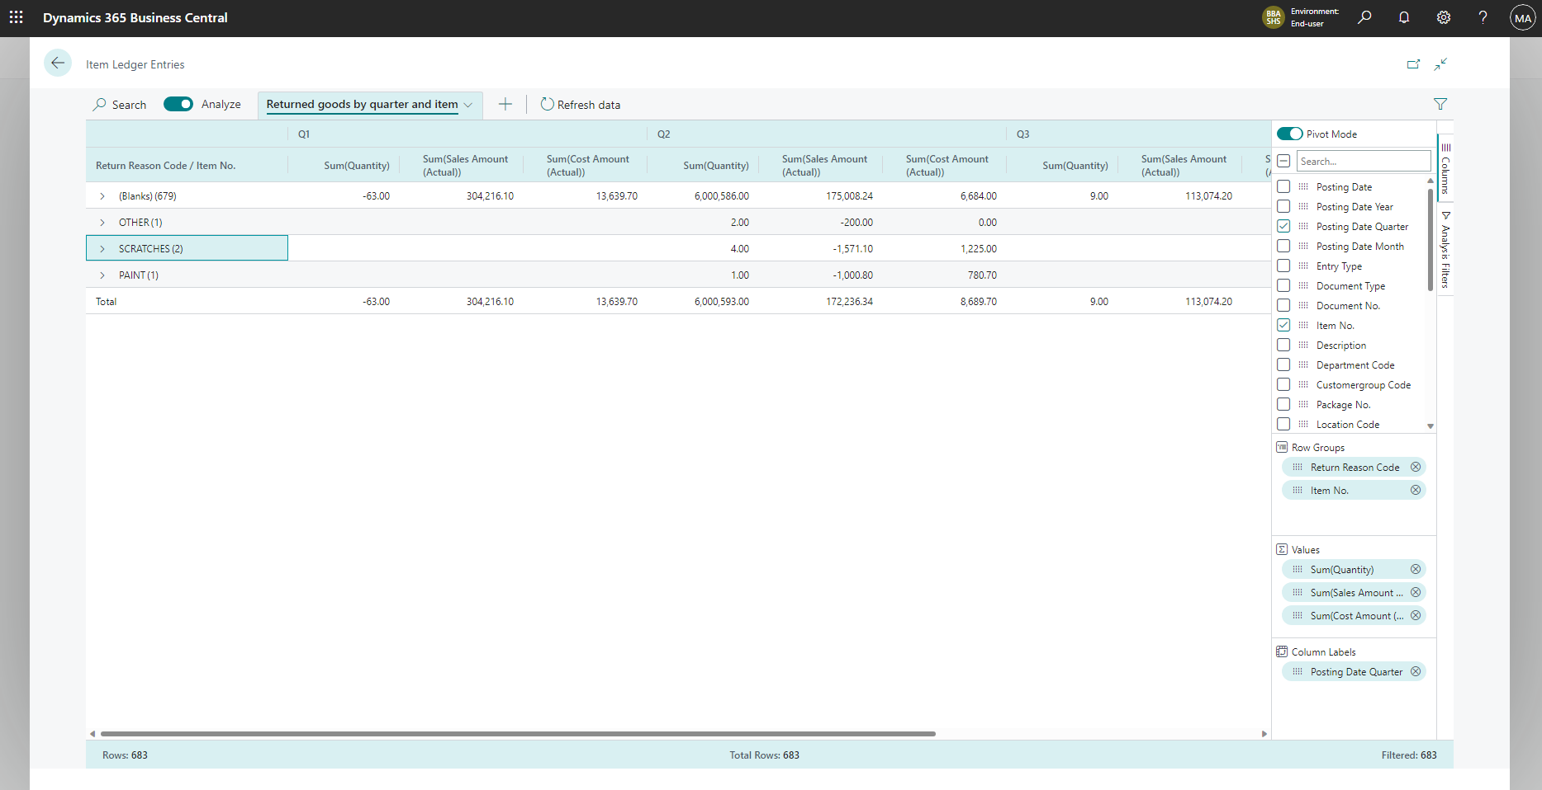
Inventory: Returned goods by Quarter and Item

Slide 30
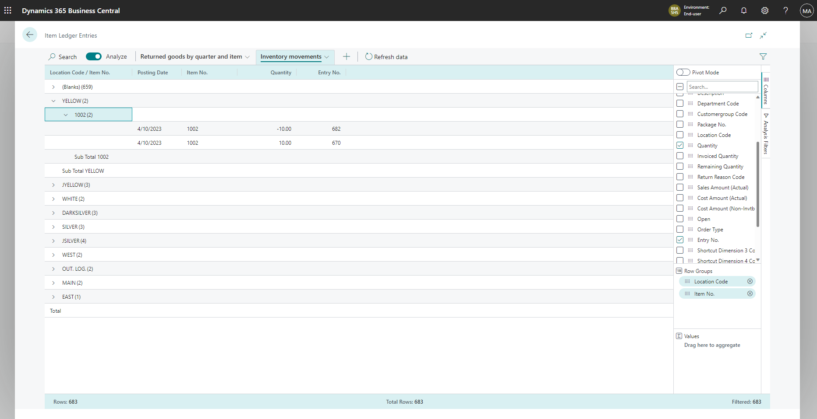
Inventory: Movements between locations

Slide 31
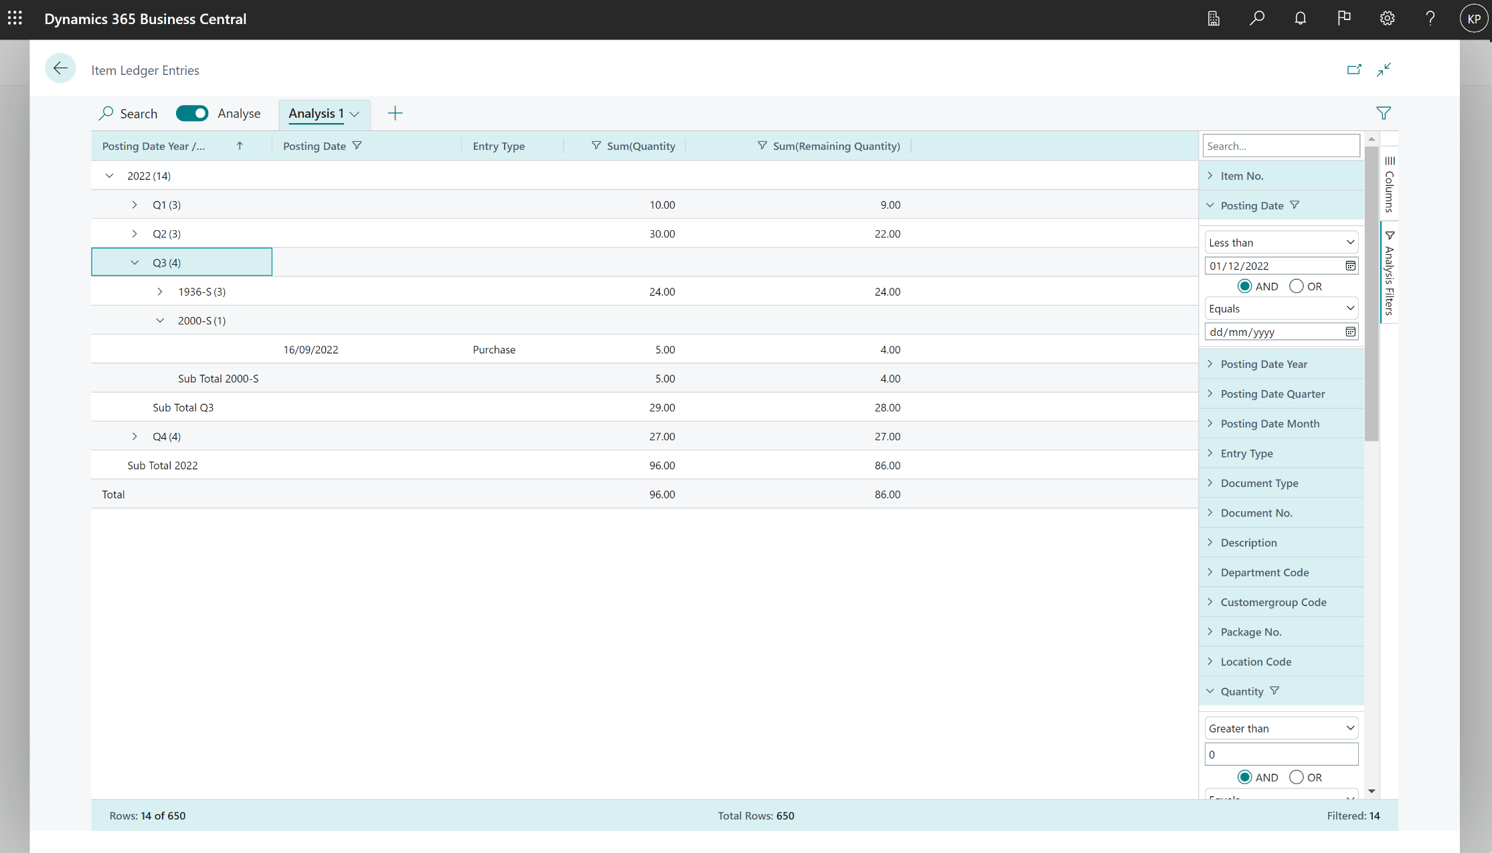
Inventory: Find “old” items on stock – defining “old”

Slide 32
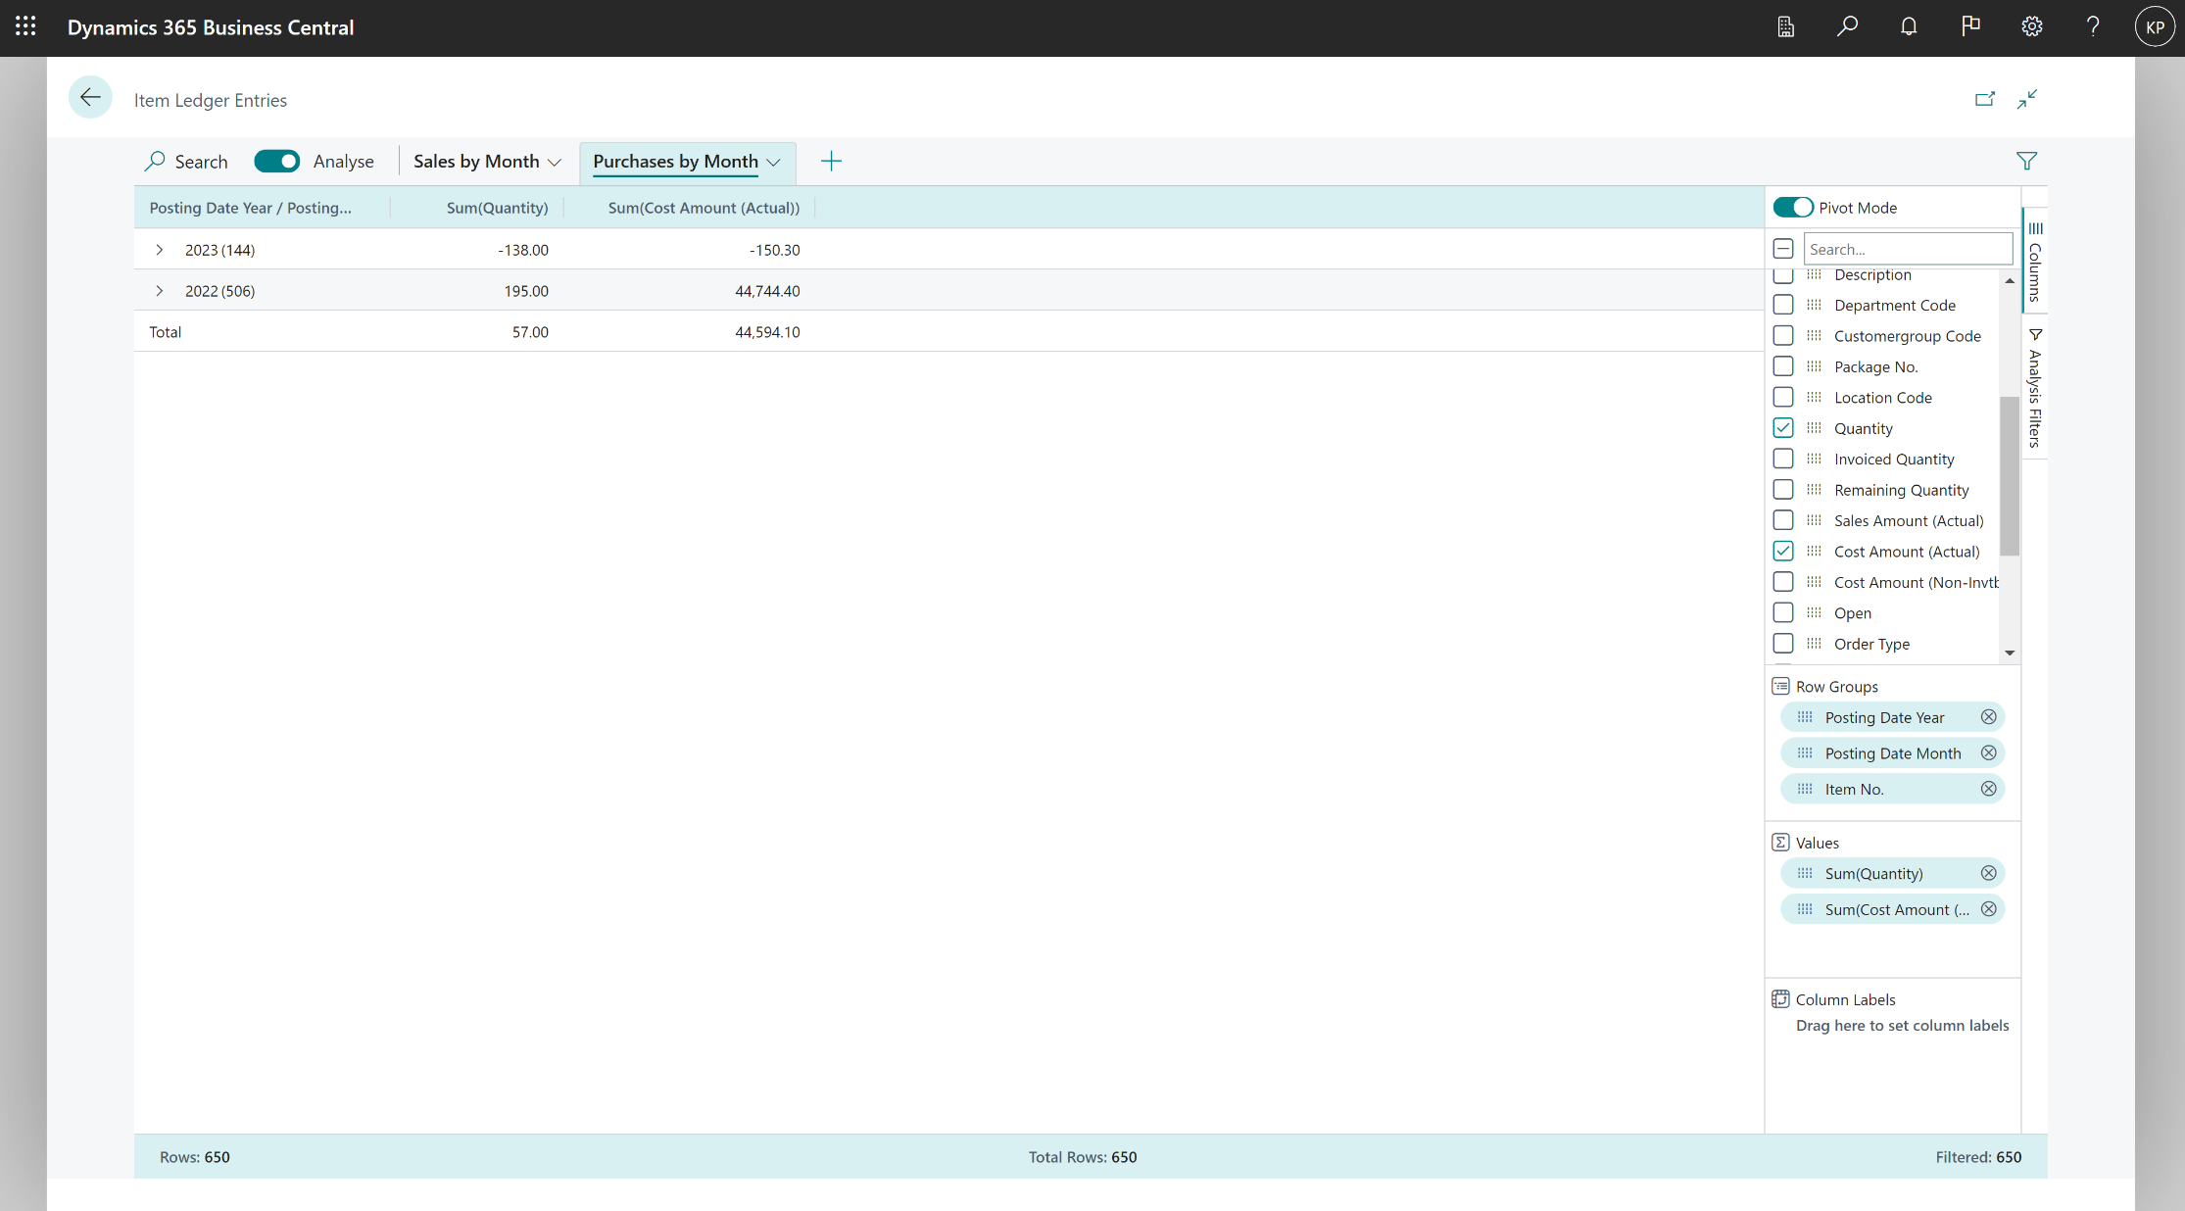
Inventory: Input/output by Month

